Slide 1
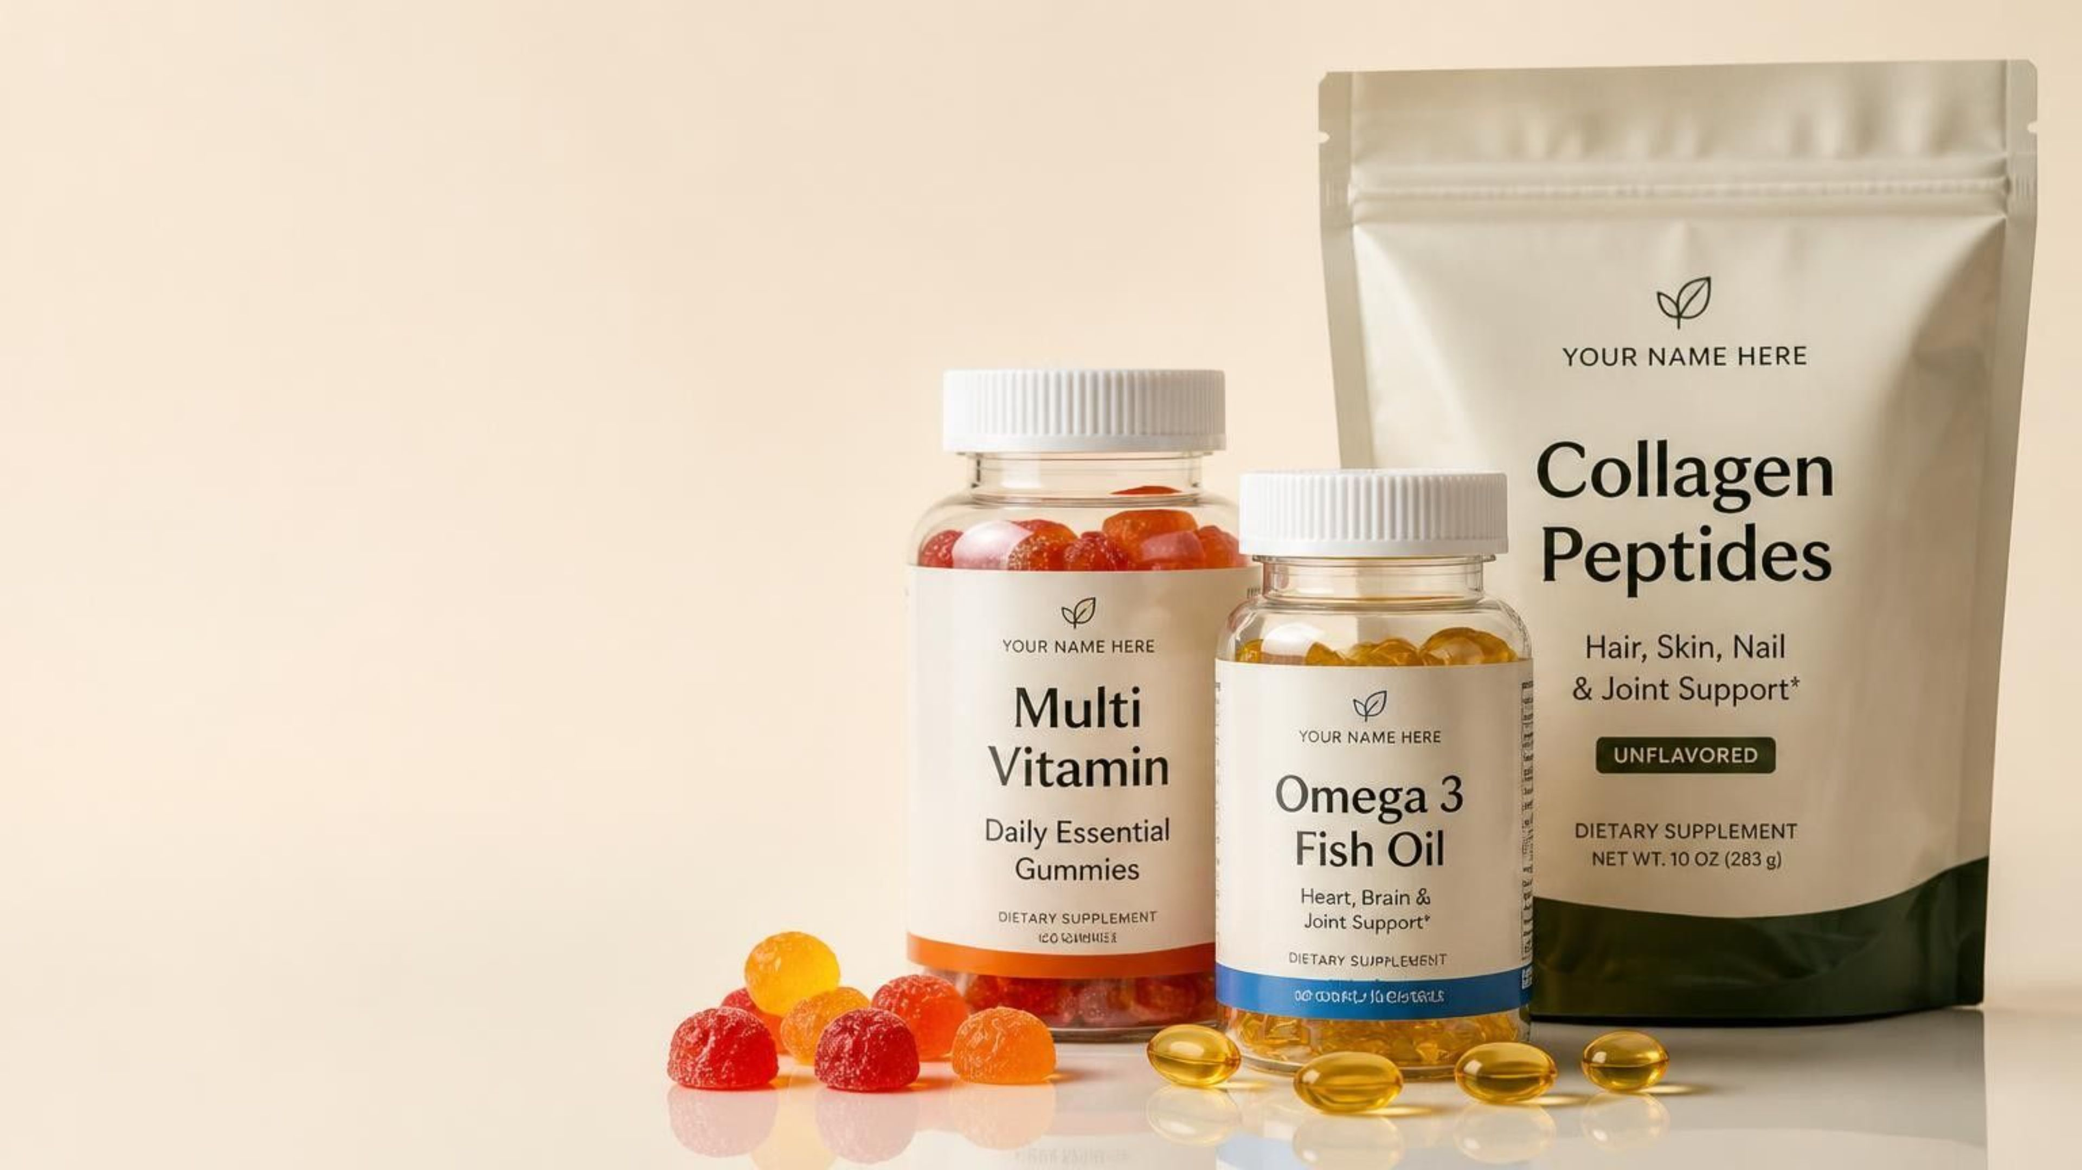
GLOBALIS GROUP
Launch your private label brand with low MOQs
Private Label • White Label • Custom Manufacturing

Slide 2
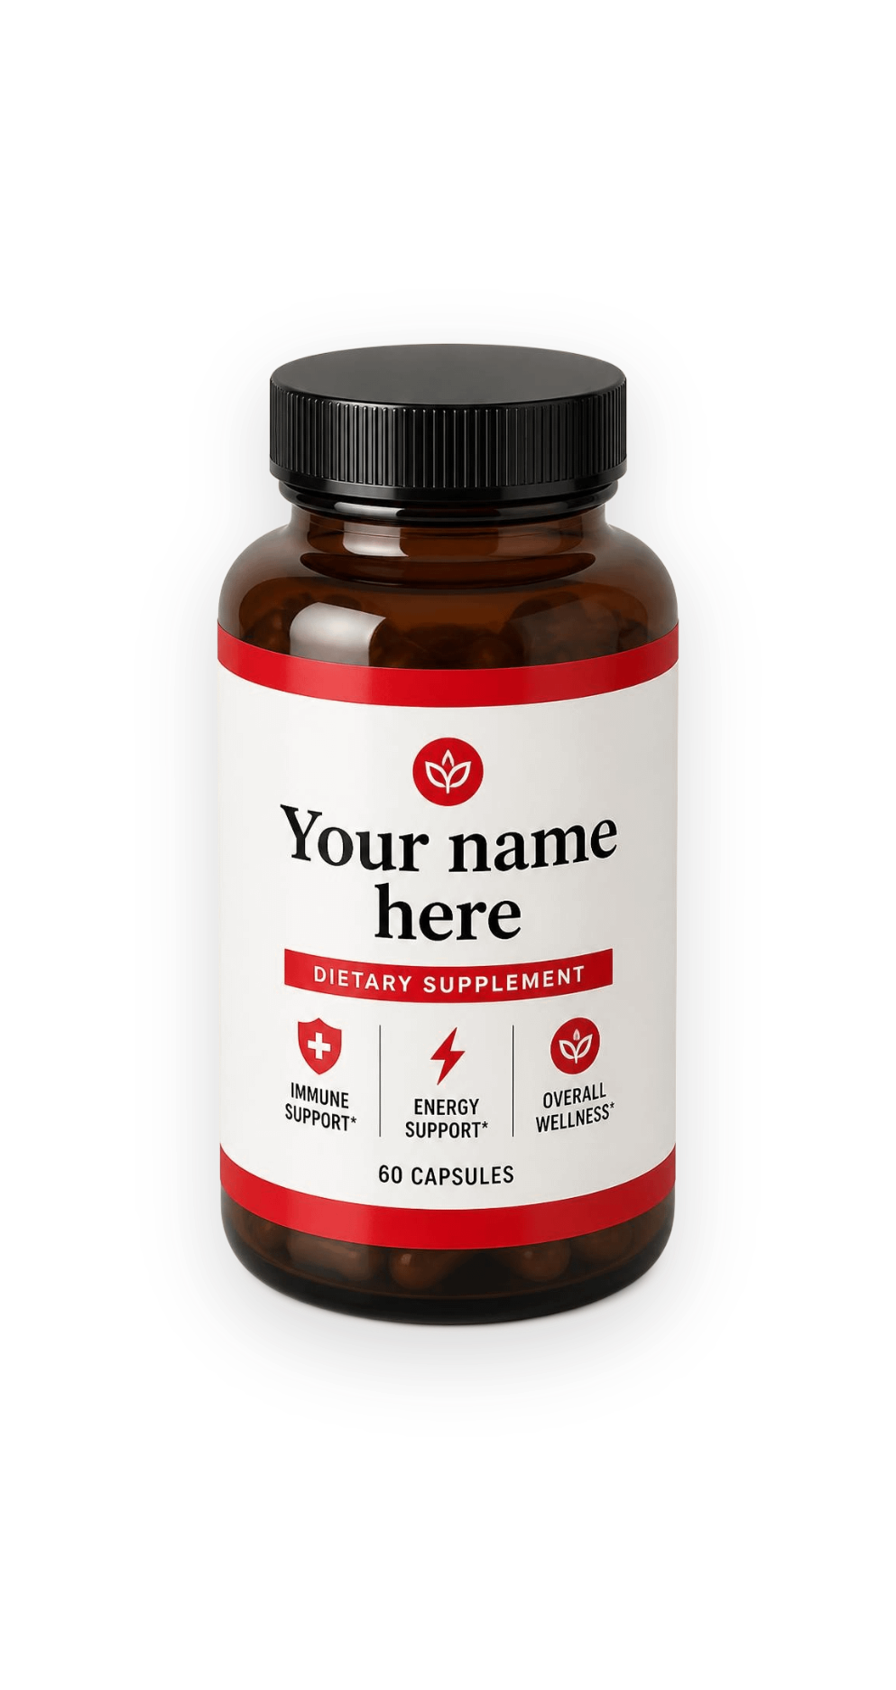
Low MOQ means a smaller bet and a faster start
Lower investment
Test the market
Less cash tied up in inventory. Less financial risk.
See how a small batch performs before scaling.
Stay flexible
Move faster than competitors
Refine products with customer feedback, without risky orders.
Respond quickly to market and demand shifts.
Built for startups and small-to-medium businesses launching compliant, market-ready supplements.

Slide 3
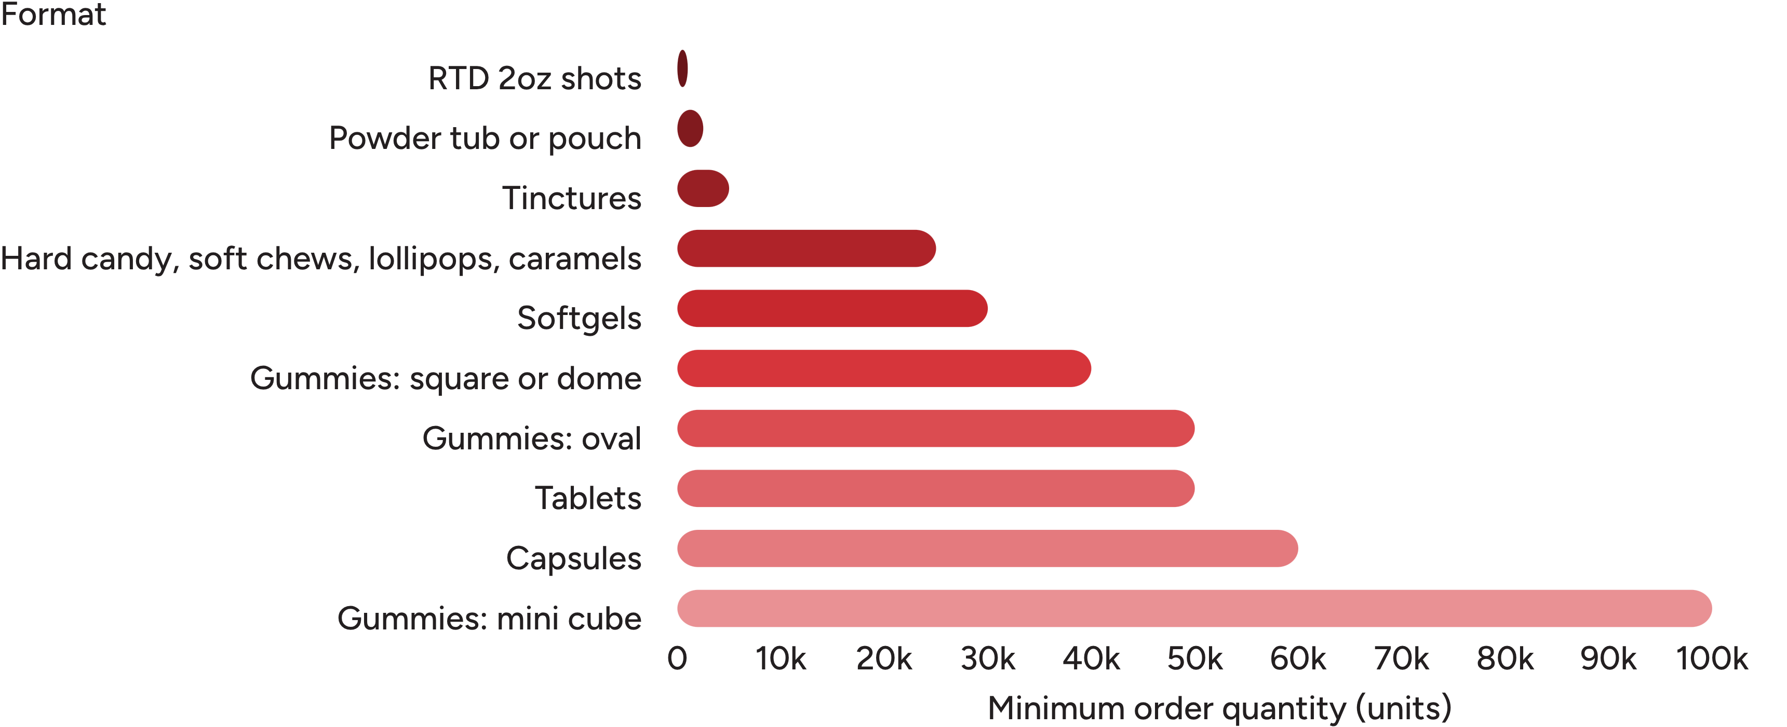
Start from just 1,000 units
Minimum order quantities by format, smallest first.

Slide 4
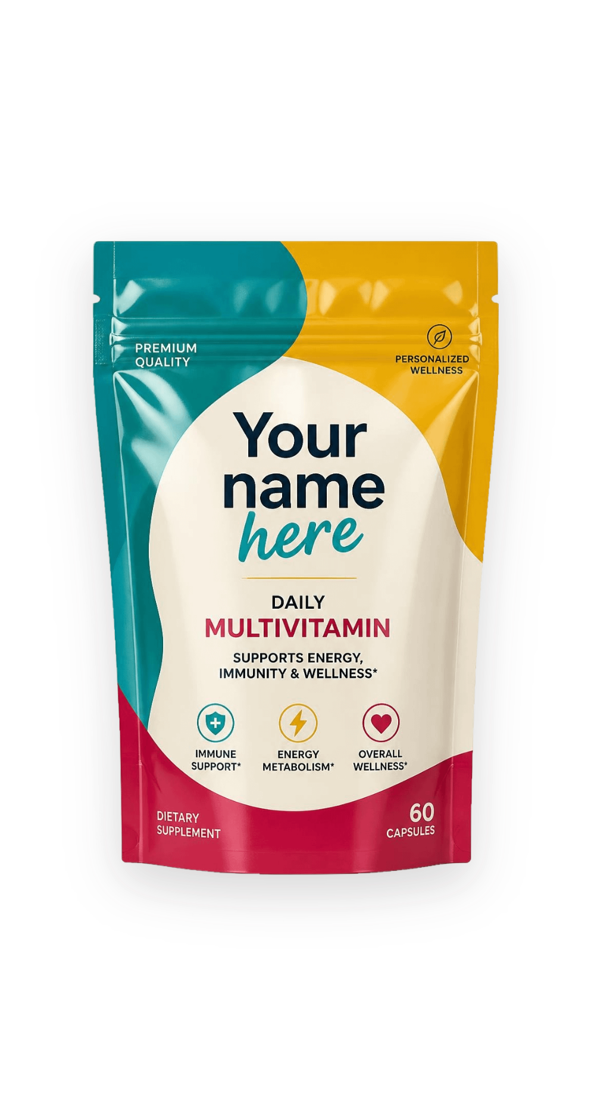
Choose the model that fits your brand
Private label
White label
Proven formulas under your name, with no formulation overhead.
Scale an existing brand on our capacity.
Custom manufacturing
Full service
Concept to delivery, with us at every step.
Bring your own formula and vision to life.

Slide 5
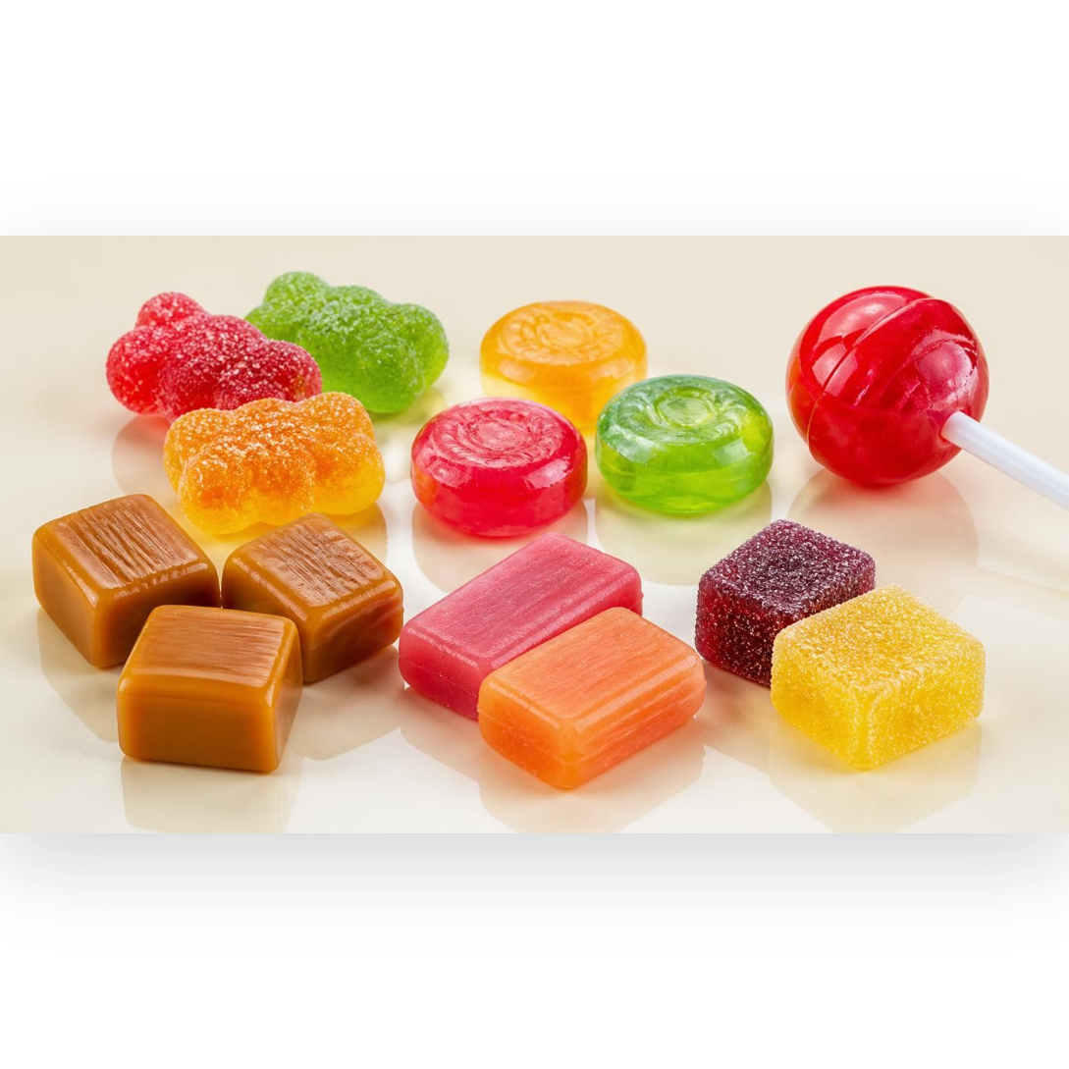
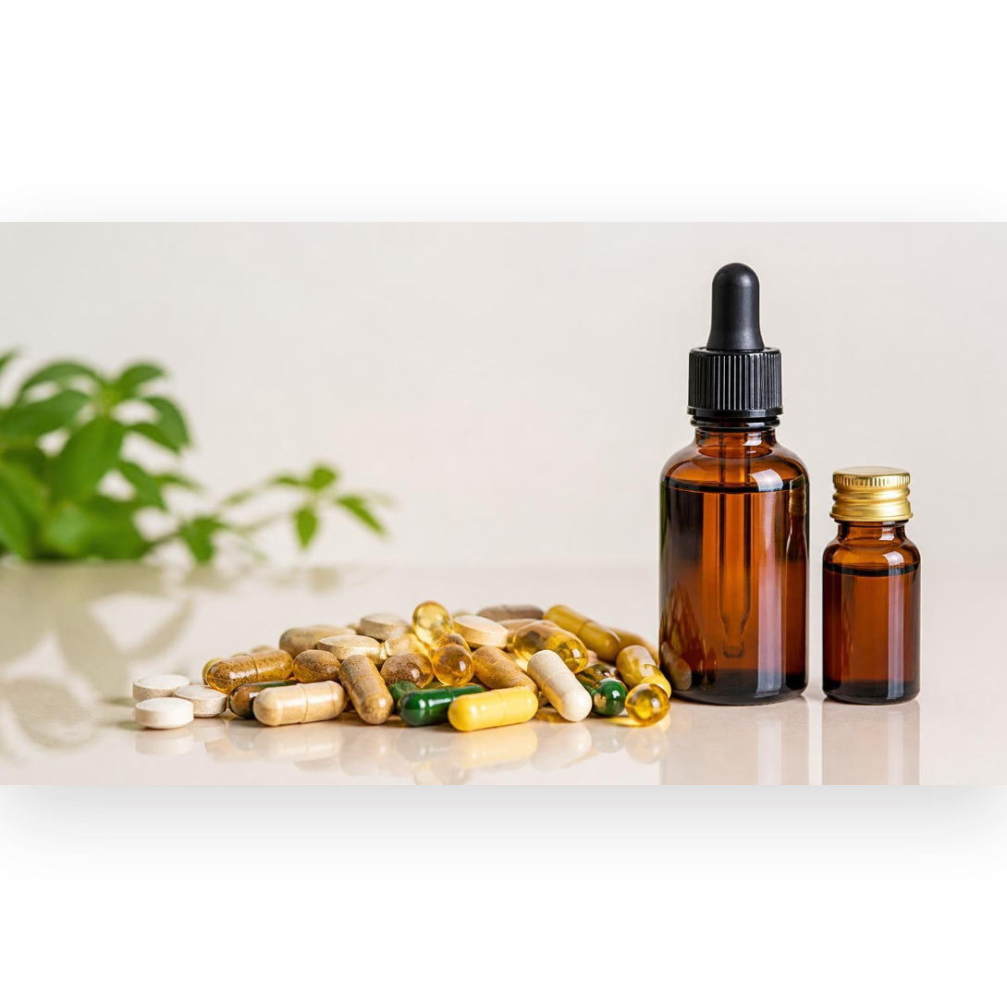
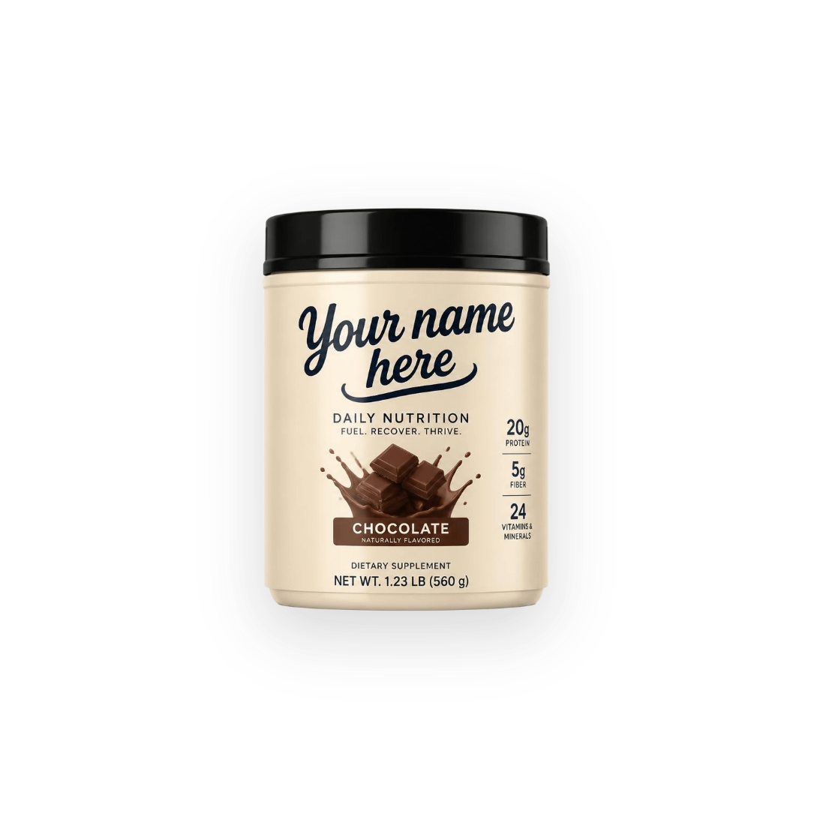
One partner, three product families
Confections
Supplements
Powders
Gummies, hard candies, caramels, soft chews, lollipops
Tablets, softgels, capsules, tinctures and shots
Drink mixes, instantized

Slide 6
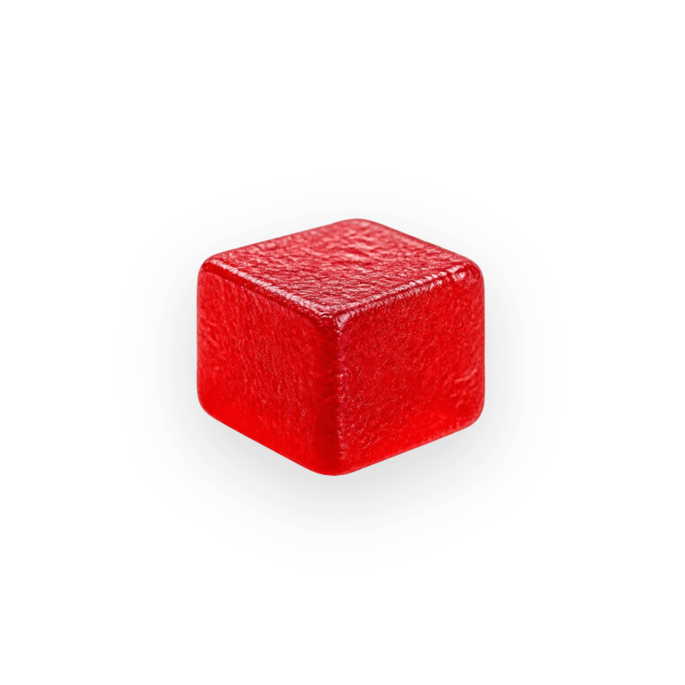
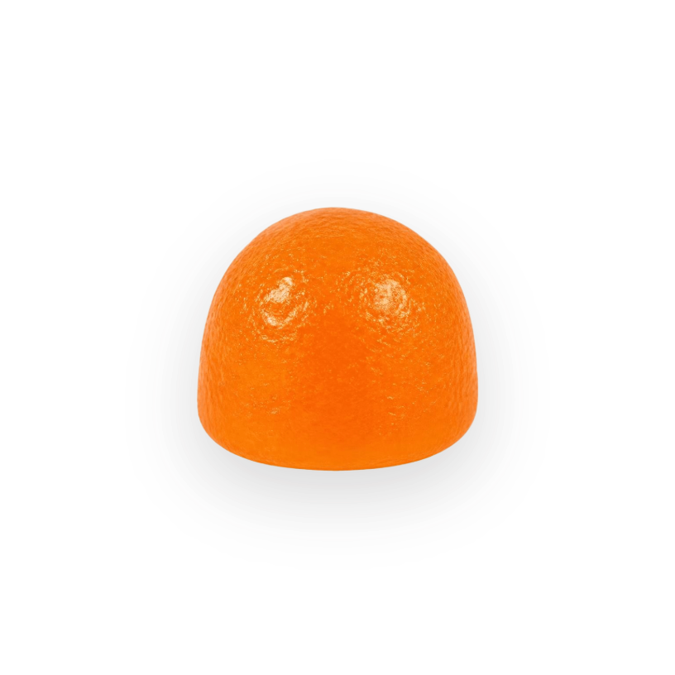
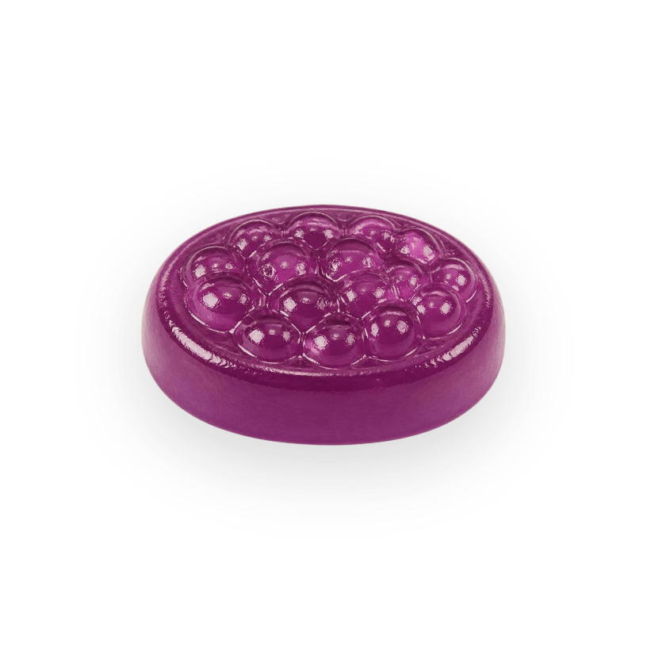
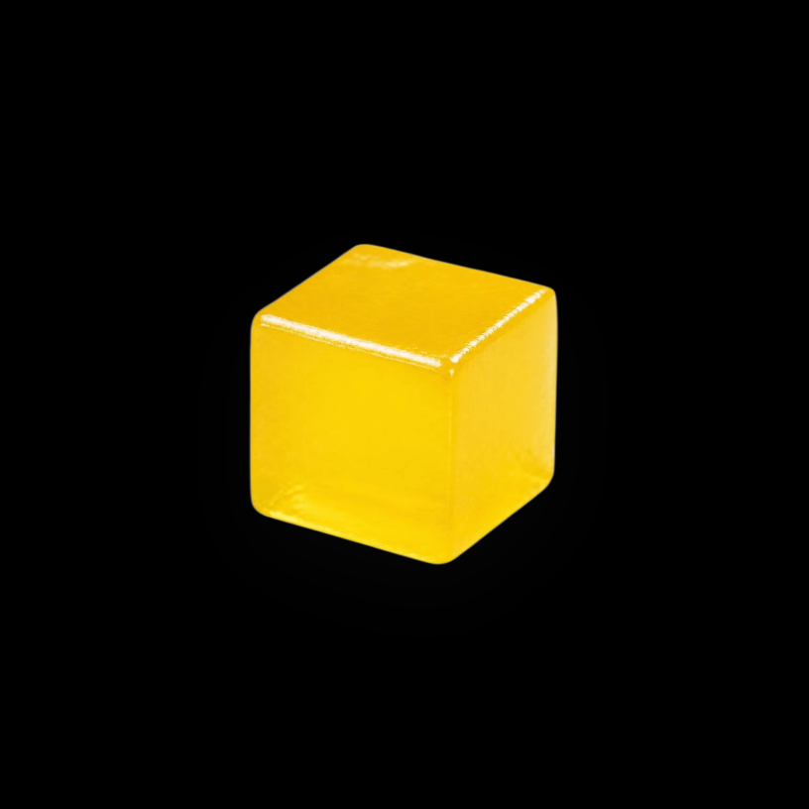
Gummies: four shapes, one favorite format
Tasty, easy to carry, versatile and precisely dosed
Square
Dome
Oval
Mini cube
From 40,000 units
From 40,000 units
From 50,000 units
From 100,000 units

Slide 7
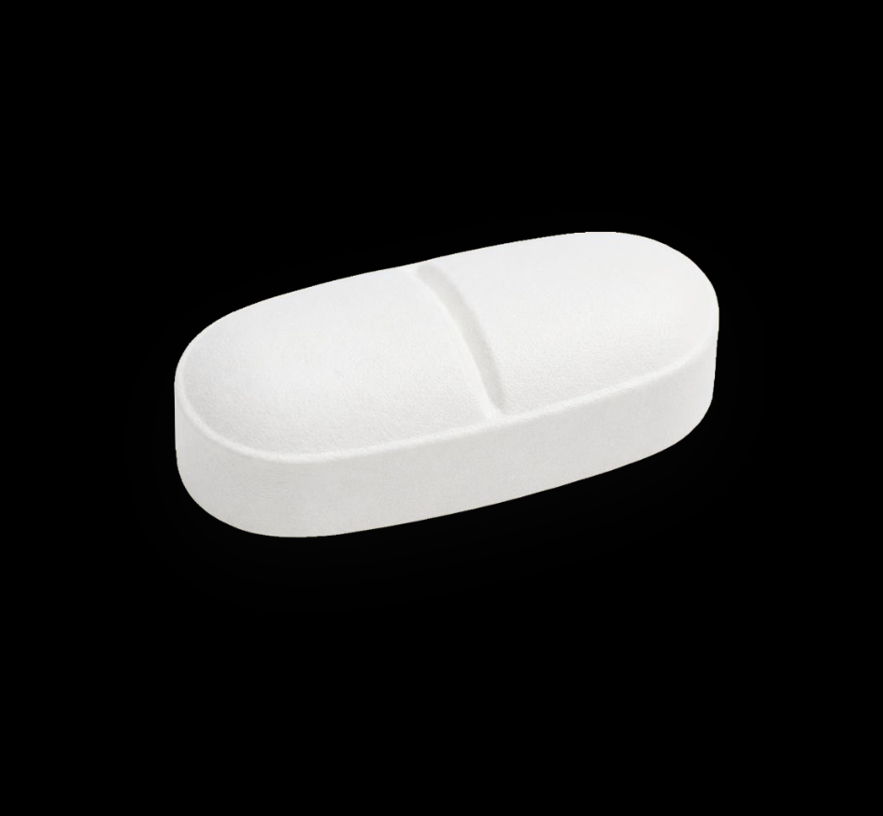
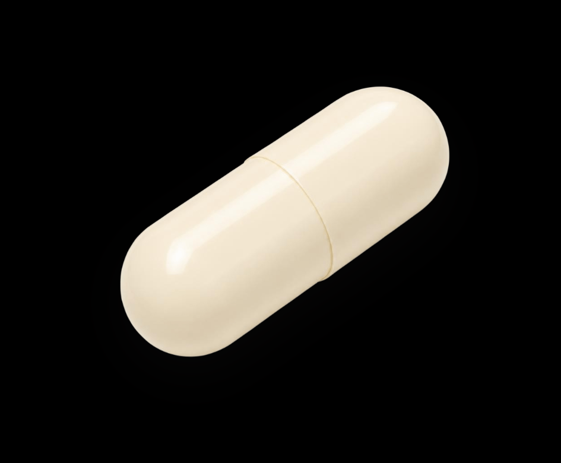
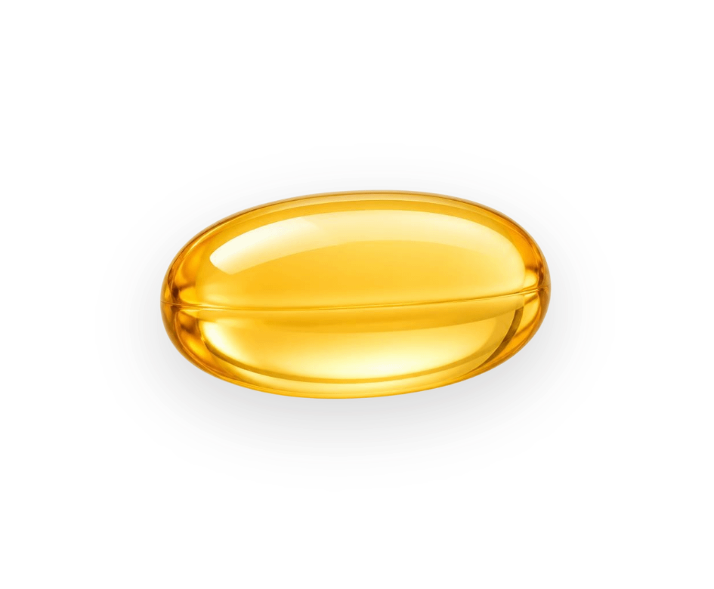
Tablets, capsules and softgels
Capsules
Softgels
Tablets
Gelatin, vegetarian, delayed release
From 60,000 units
Standard, vegetarian, enteric-coated
From 30,000 units
Chewable, coated, effervescent
From 50,000 units
Precise dosing and better absorption

Slide 8
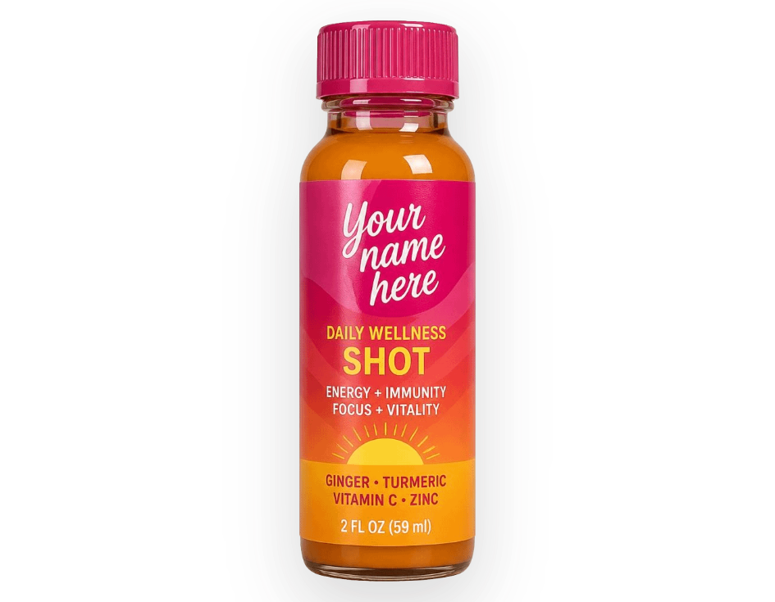
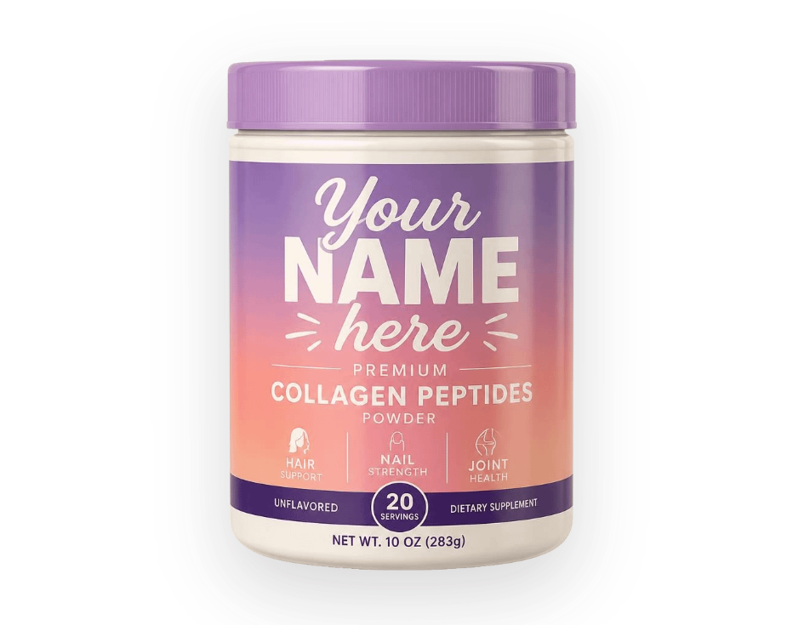
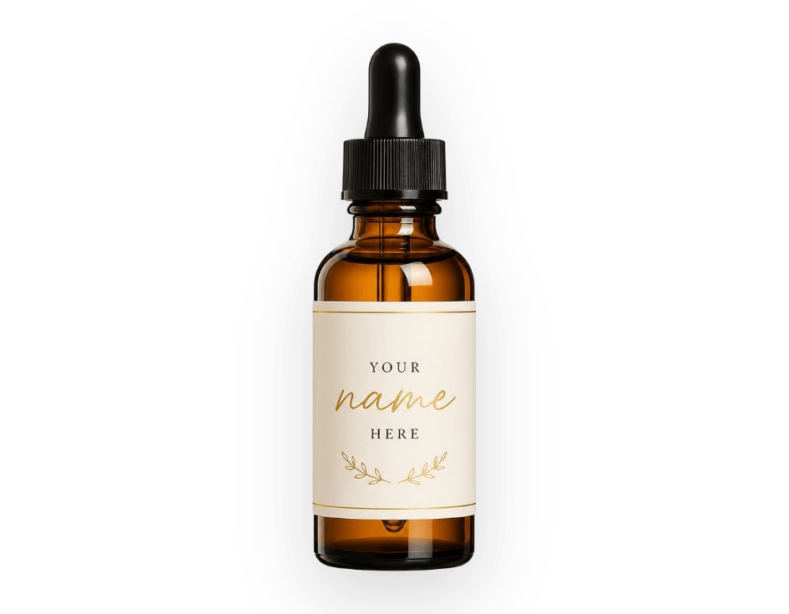
Powders, tinctures and shots for the smallest launches
1,000
2,500
5,000
Ready-to-drink 2oz shots
Powder tubs or pouches
Tinctures
Starting MOQ, units
Starting MOQ, units
Starting MOQ, units · fast-absorbing
Stick packs and sachets from 50,000 units; liquid sachets from 100,000 units.

Slide 9
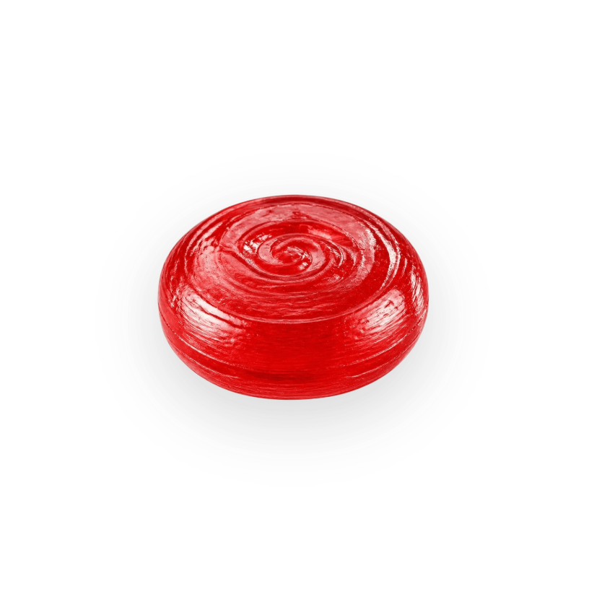
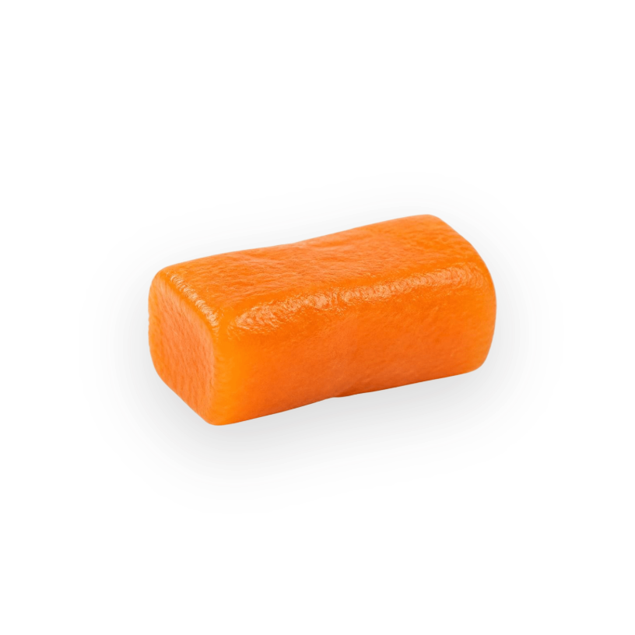

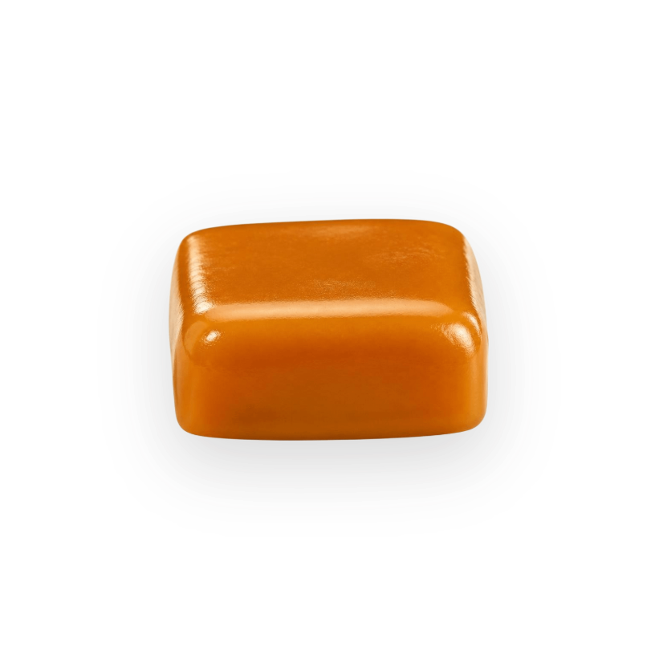
Candy-style supplements people actually enjoy
Hard candy
Soft chews
Lollipops
Caramels
Classic or sugar-free
From 25,000 units
Vegan
From 25,000 units
Vegan and gluten free; organic on request
From 25,000 units
Gluten free
From 25,000 units

Slide 10
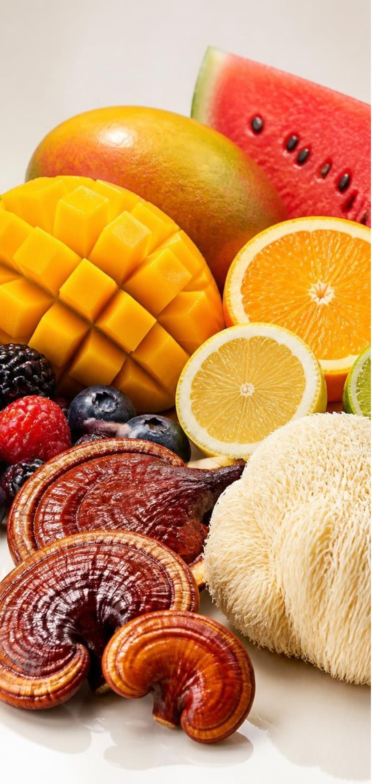
Build your own formula: active, add-ins, flavor
Actives
Formulas
Herbal extracts, functional mushrooms, vitamins, nootropics
Beauty, immunity, focus, energy, sleep, multivitamin, women's health, pre and post workout and more
Add-ins
Flavors
Reishi, lion's mane, ginseng, melatonin, vitamin D3, magnesium, probiotics, L-theanine and more
Mango, mixed berry, watermelon, pina colada, citrus and custom flavors

Slide 11
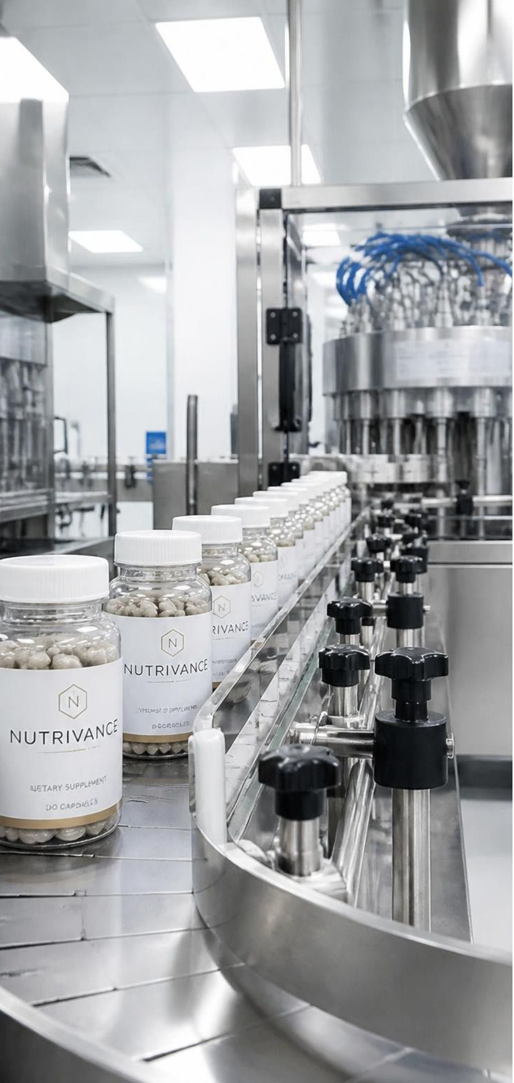
Six steps from first call to reorder
01
02
Consultation
Development
Free review of goals, specs, timeline and cost estimates
Formulation, flavor and color matching, ingredient sourcing
03
04
Sampling
Production
Test samples, safety testing, shelf-life and packaging trials
Documented, monitored runs
05
06
Quality assurance
Delivery and support
Multi-point testing; unique lot code per batch for traceability
Climate-controlled shipping, documentation, easy reorders

Slide 12
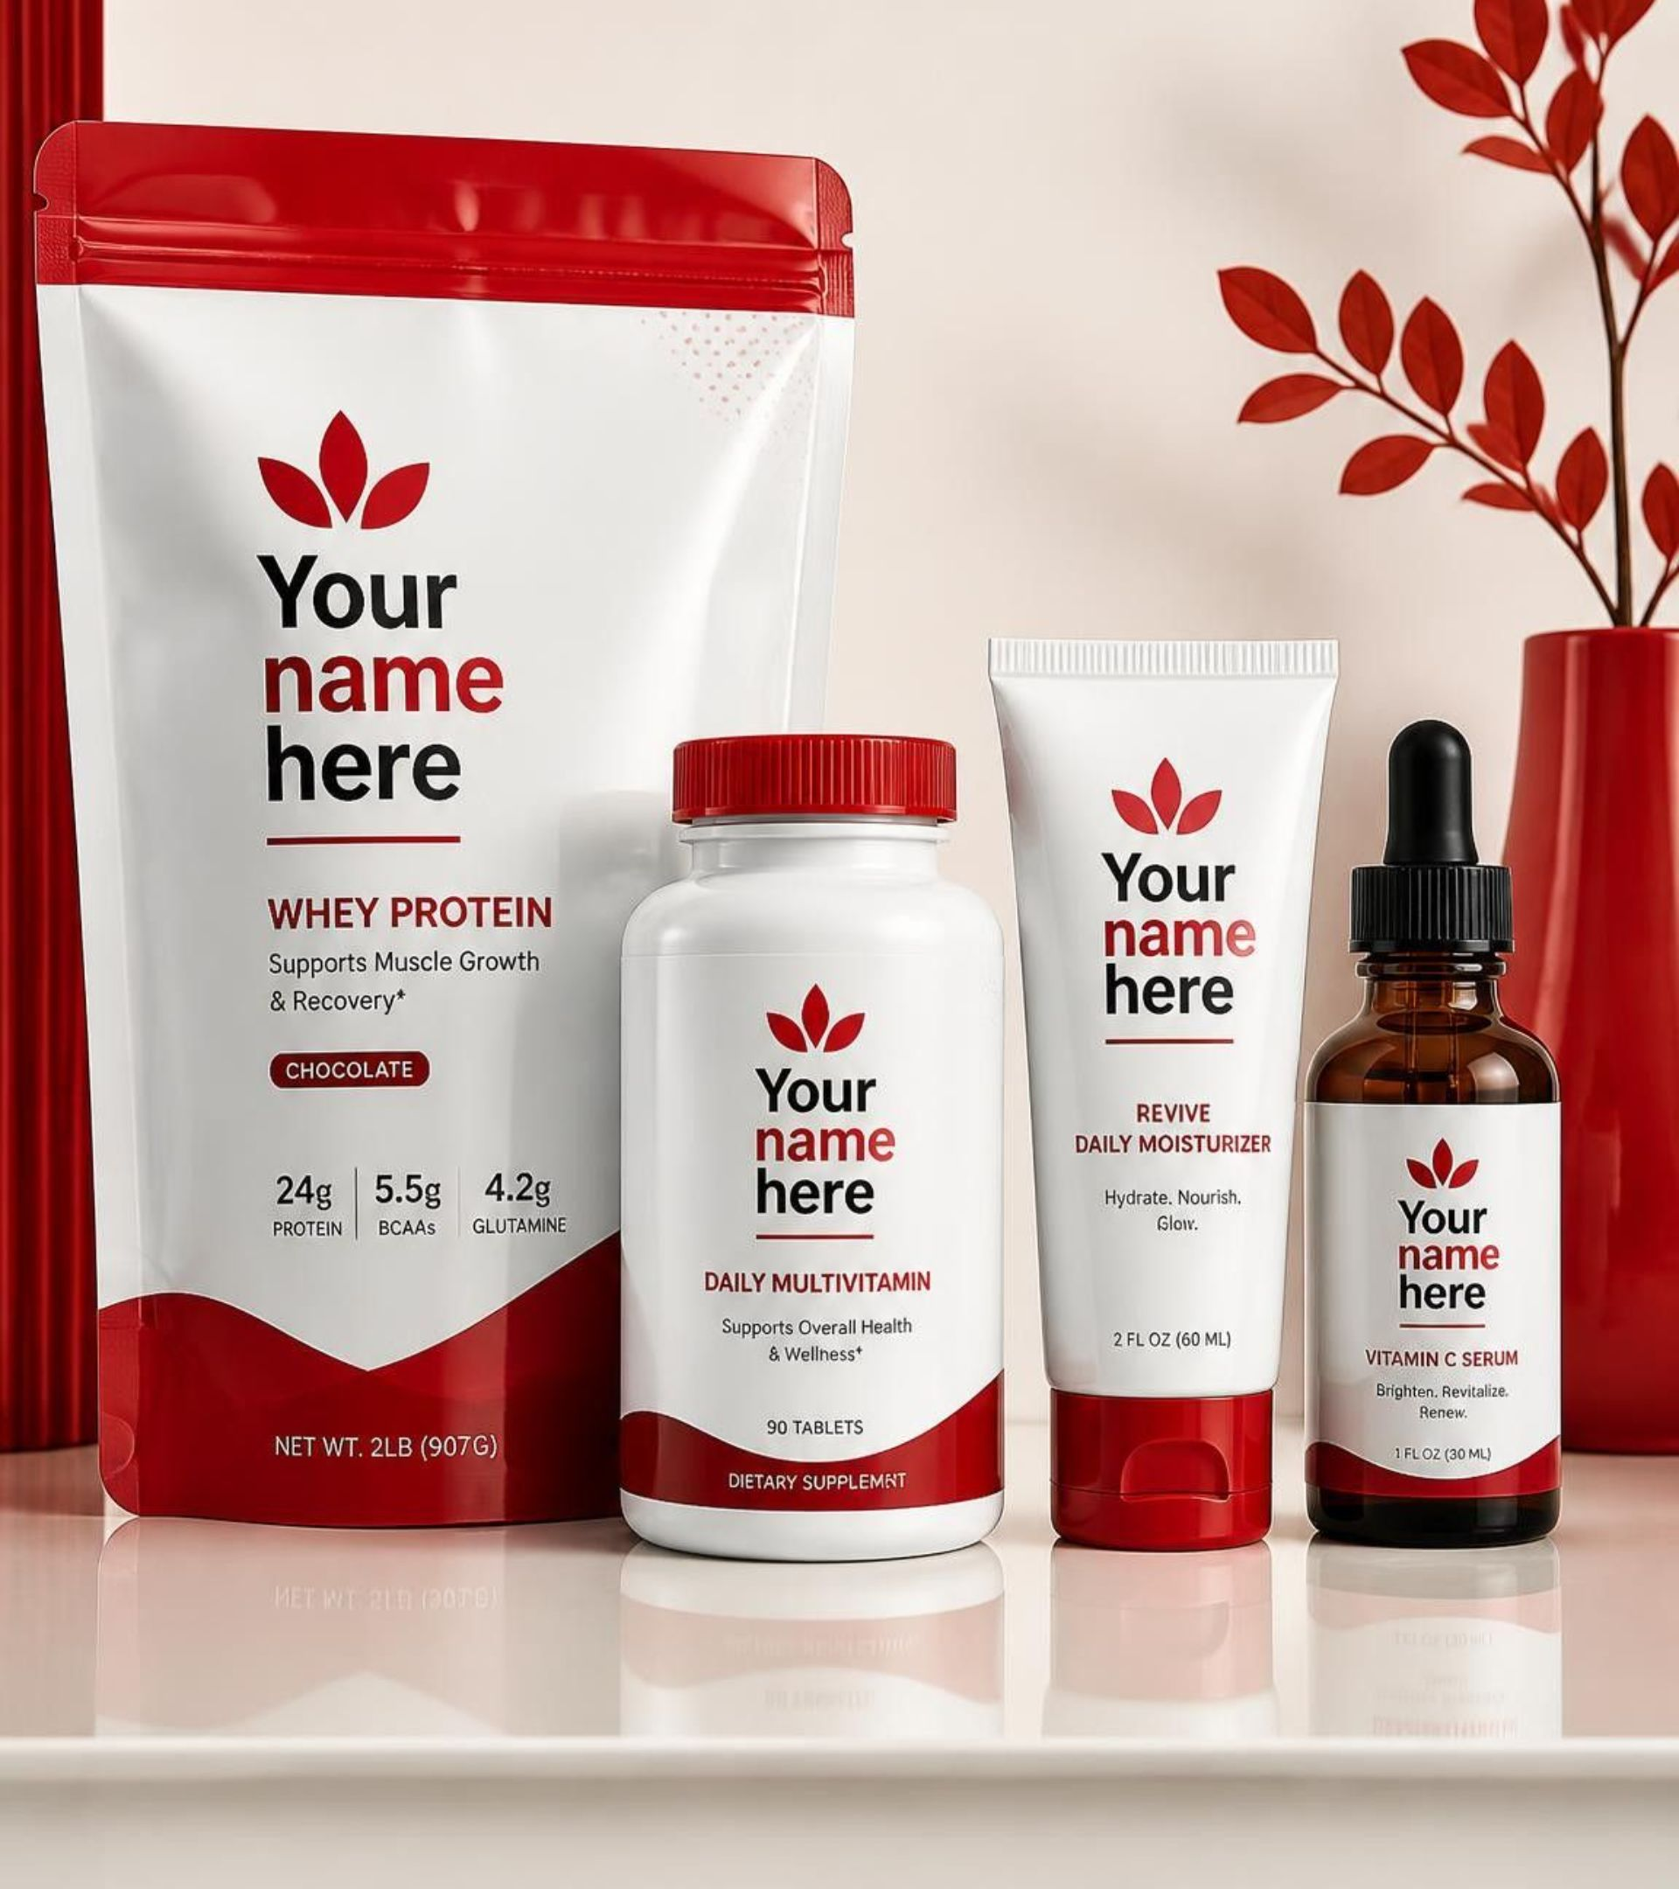
Packaging that sells on the shelf
No logo or design yet? We build your brand identity from the ground up.
Custom packaging and display solutions that protect your product
Pouches, bottles, tubes and droppers, within your budget

Slide 13




Certifications you can trust
cGMP
FDA registered
Consistent, safe batches
Non-GMO and vegan
Made in USA
Verified suppliers and batch tracking
American facilities and skilled workforce

Slide 14
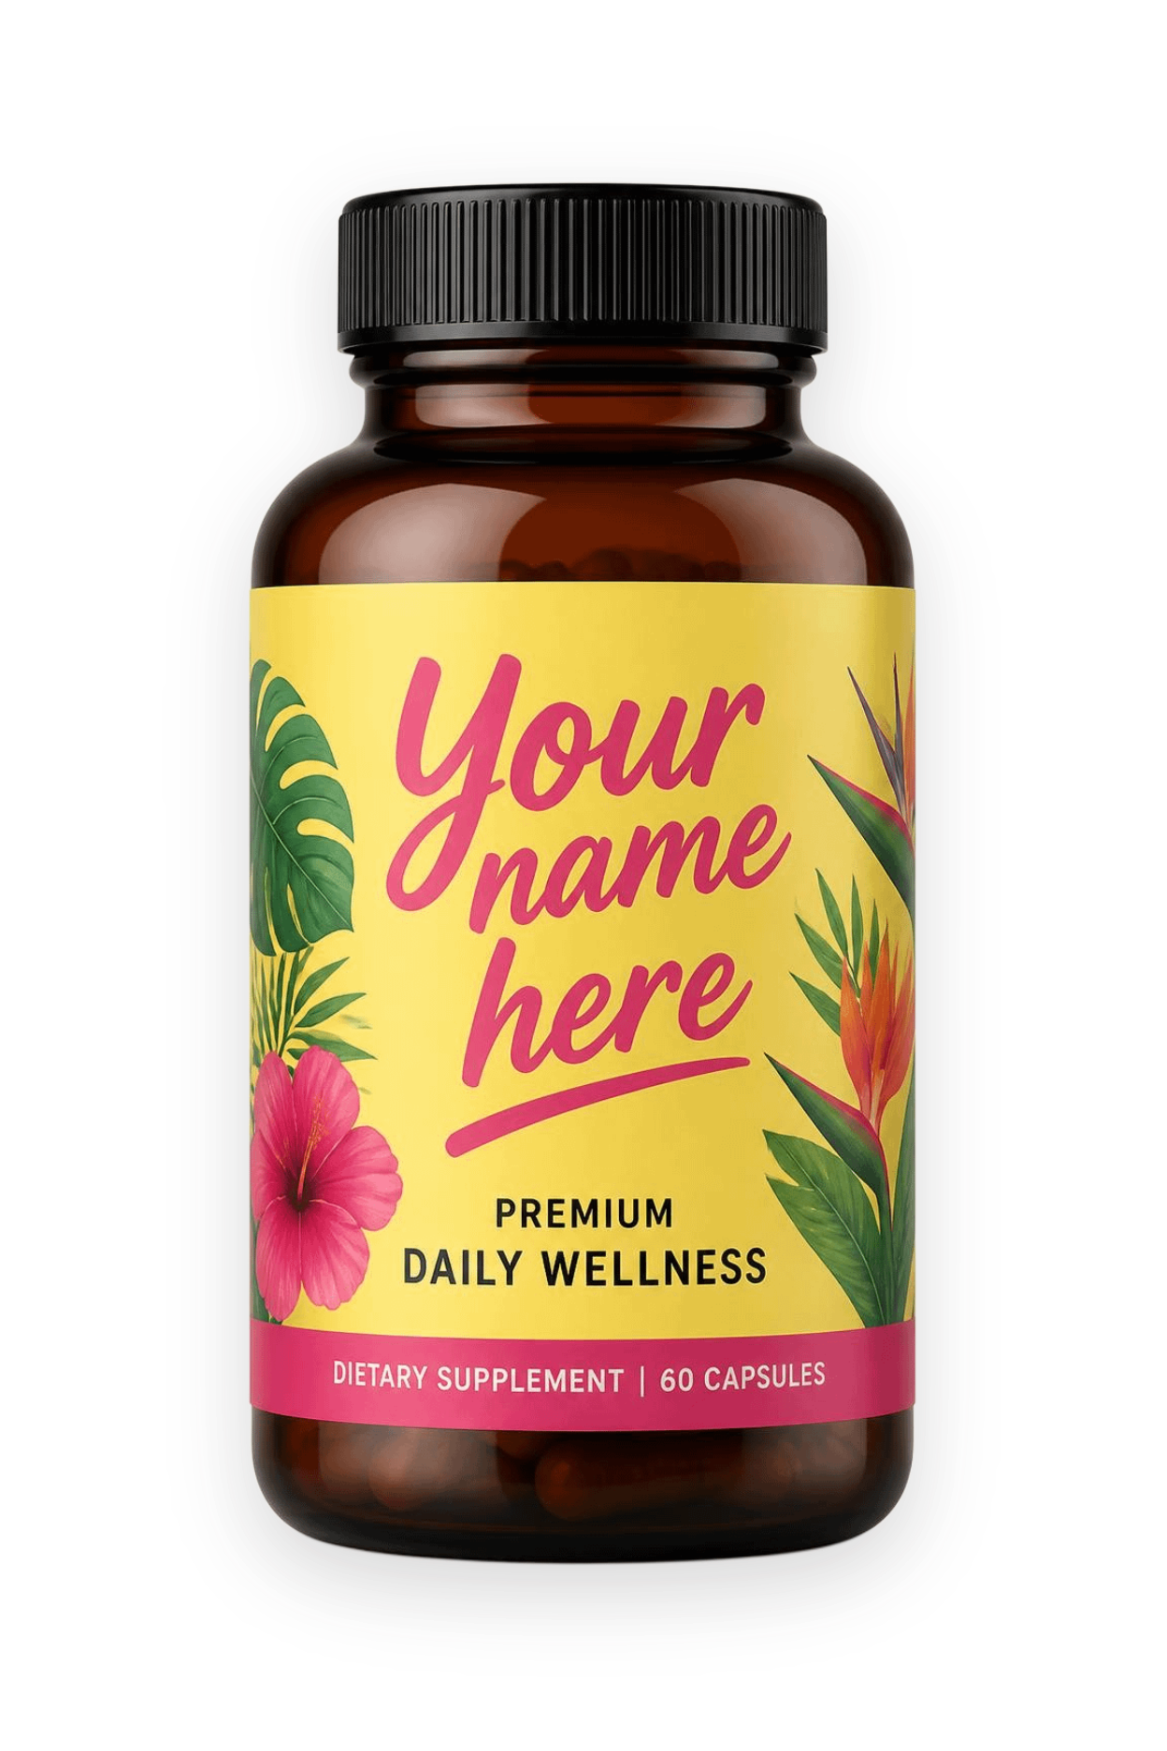
Ready to launch your brand?
Tell us what you want to make and we'll show you how small you can start.
Call 619-721-4955
Email info@globalisgroup.net

