Slide 1

Peptide Excellence: Products, Capabilities & Partnership

Slide 2

Peptide Therapeutics & Clinical Innovation
A commercial & scientific overview for healthcare professionals across North, Central and South America
Lyophilized Formats
California Manufacturing
COA Documentation
Private Label ≥ $5K / SKU

Slide 3
EXECUTIVE SNAPSHOT
Why Peptide Therapeutics Are Attracting Attention
Clinical, commercial and manufacturing interest in peptide therapeutics is accelerating — driven by a growing body of approved products, a large global market, and North America's dominant share.
130+
$294.6B
FDA-Approved Peptide RLDs
Global Market Forecast
Reference-listed drug products — FDA GDUFA workshop, 2025
Peptide therapeutics forecast for 2033 — Grand View Research, 2026
61.9%
$5K
North America Share
Private-Label Eligibility
Share of global peptide revenue in 2025 — Grand View Research, 2026
Minimum per SKU — Globalis Group commercial model

Slide 4


GLOBALIS GROUP
Value Proposition
Competitive, scalable peptide sourcing with California-based manufacturing support and COA documentation — structured for clinics, physician networks, distributors and qualified healthcare organizations across the Americas.
Regulatory status and permitted use vary by peptide and jurisdiction. Product quality documentation does not itself establish FDA approval or authorization for patient administration.

Slide 5
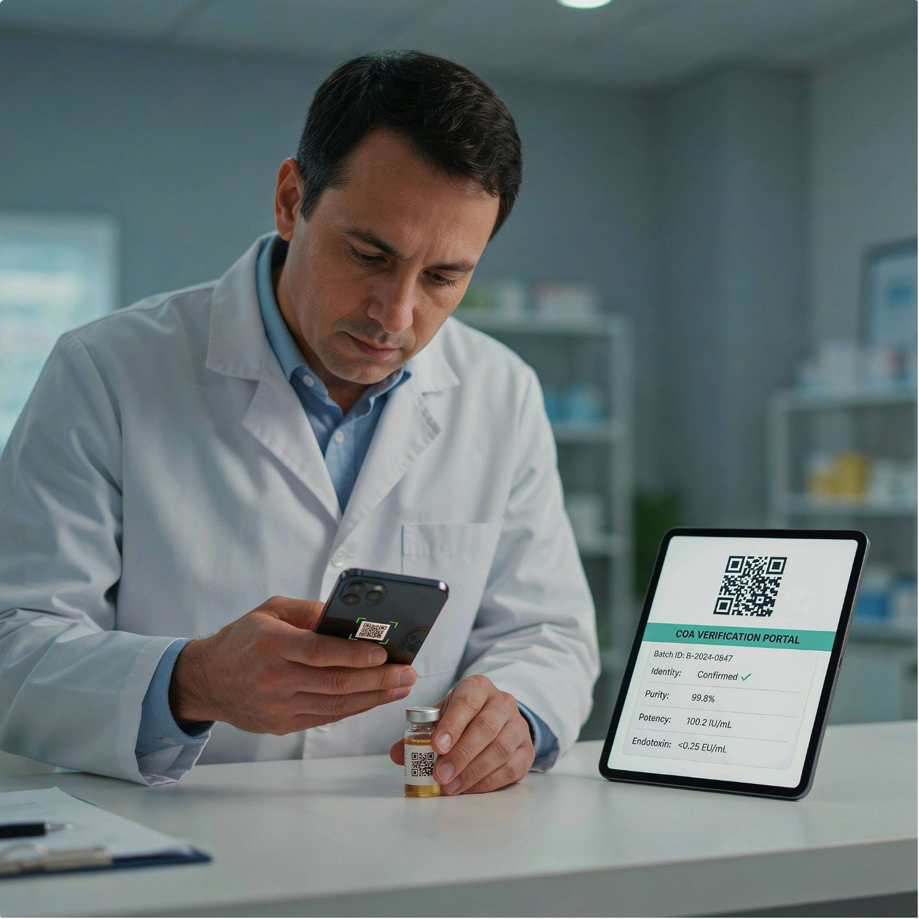
GLOBALIS GROUP
We offer a QR-based COA verification portal — the physician scans the vial and can view batch-specific identity, purity, potency, and endotoxin results.
With our Clinical Portal, physicians can review outcomes tracking, protocols, and patient history. No peptide supplier currently offers this service.
Unique Tool

Slide 6

What Are Therapeutic Peptides?
A modality positioned between conventional small molecules and larger biologics — therapeutic peptides work through a precise, sequential mechanism.
High‑Affinity Target Binding
Biological Signaling
Selective engagement with intended molecular targets.
Activation or modulation of downstream pathways.
Short Amino‑Acid Chains
Therapeutic Effect
Clinical outcomes from targeted pathway modulation.
Compact peptides form the therapeutic scaffold.
Why Clinicians Value Them
Technical Challenges
High target affinity and selectivity
Mechanisms that mirror endogenous signaling
Chemical design can tune half-life, potency and delivery
Broad applicability across metabolic, endocrine, oncology and rare disease
Proteolytic degradation and short half-life
Low oral bioavailability; parenteral delivery remains important
Impurities, aggregation and immunogenicity require robust control
Stability, reconstitution and storage must be validated by product

Slide 7
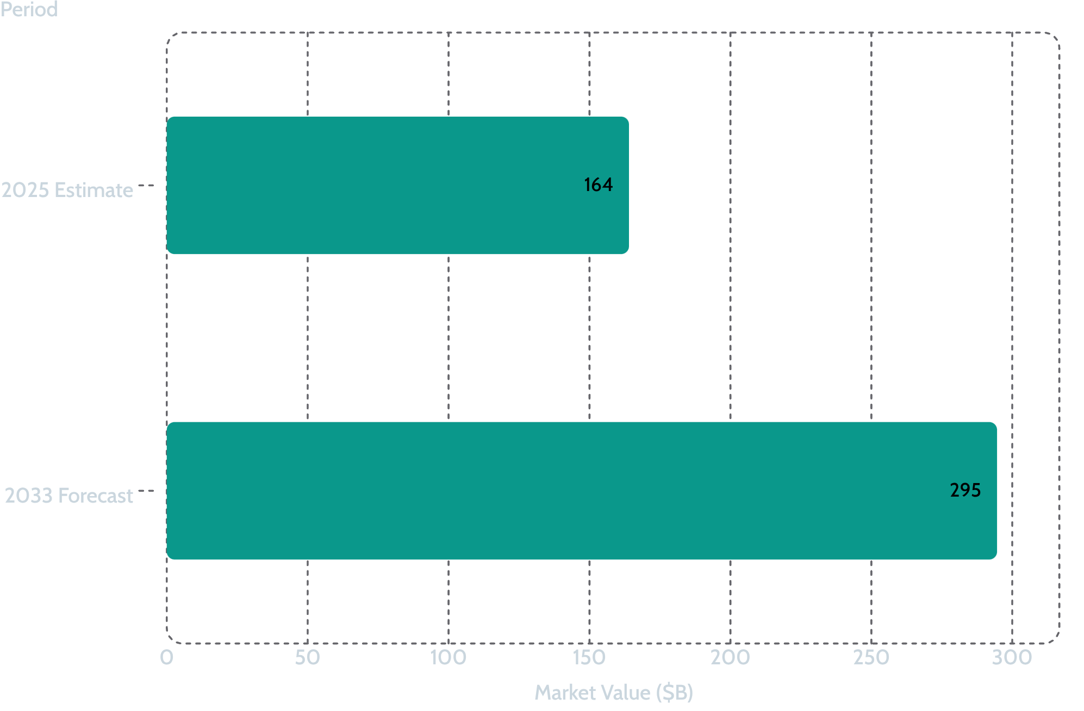
MARKET GROWTH
Global Peptide Therapeutics — The Market Is Scaling Rapidly
Key Drivers
8.7% CAGR projected 2026–2033
Metabolic disorders represented 63.6% of revenue in 2025; parenteral routes accounted for 84.0%.
U.S. Outlook
$95.8B — 2026 estimate
$186.3B — 2033 forecast
10.0% CAGR
North America held 61.9% of global revenue in 2025.

Slide 8

Peptide Landscape — Where the Market Is Developing
Selected categories and examples; not a complete catalog and not an indication that every molecule is approved for clinical use.
Weight & Metabolism
Recovery & Injury
Semaglutide (GLP-1) • AOD-9604 • Cagrilintide • Tesofensine •
Retatrutide • Tirzepatide • Lipo Mino • SLU-PP-332
BPC-157 • TB-500 (Thymosin β4) • ARA-290
Immune & inflammation
Anti-aging & GH
KPV • Thymosin Alpha-1 • Thymogen • LL-37 + Quercetin + EGCG
Elamipretide • MOTS-c • Epitalon • GHK-Cu • Tesamorelin • NAD+ •
Cartalax • Follistatin 344 • Cardiogen • Ibutamoren • Sermorelin
Brain & Sleep
Sexual Health
Semax • Selank • DSIP • Dihexa • PNC Cocktail • NAD+ + BDNF + Alpha + GPC • Selank (Nasal Spray) • Semax (Nasal Spray)
PT-141 (Bremelanotide) • EndoTest (Kisspeptin + Oxytocin) • Melanotan II • MT-II + PT-141 + Oxytocin
Clinical opportunity exists across multiple specialties — but responsible commercialization depends on molecule-specific evidence, manufacturing controls and local regulatory pathways.

Slide 9
QUALITY & SUPPLY
Quality, Documentation & Lyophilized Supply
For peptide programs, analytical transparency is central to professional trust.
01
02
03
California-Based Manufacturing
Lyophilized Presentation
COA Documentation
Validated freeze-dried formats support stability and standardized storage/reconstitution workflows for many peptides.
COAs available by peptide / lot as applicable, supporting traceability and review of analytical specifications.
Production through a California laboratory partner; regulatory credentials matched to current establishment documentation.
04
05
Quality Attributes
Microbial Controls
Typical controls include identity, purity, assay/content, related substances and other product-specific tests.
Sterility, bioburden or endotoxin testing should only be claimed when actually performed and reported for the SKU / lot.

Slide 10
COMMERCIAL STRUCTURE
Built for Scale — Tiered Pricing
Competitive pricing improves with purchasing volume. Exact quotes vary by peptide, format, testing and destination.
10 vials per SKU — Entry Tier
$5,000 — Growth Tier
$10,000 — Scale Tier
Initial stocking / evaluation. Competitive starting pricing for new partners.
Preferred commercial economics. Private-label eligibility per SKU begins here.
Best volume economics. Designed for strategic purchasing and distribution partners.
Tier amounts reflect purchasing bands. Final unit pricing is SKU-specific and may change with peptide cost, concentration, vial/pack configuration, testing requirements, packaging and logistics.

Slide 11
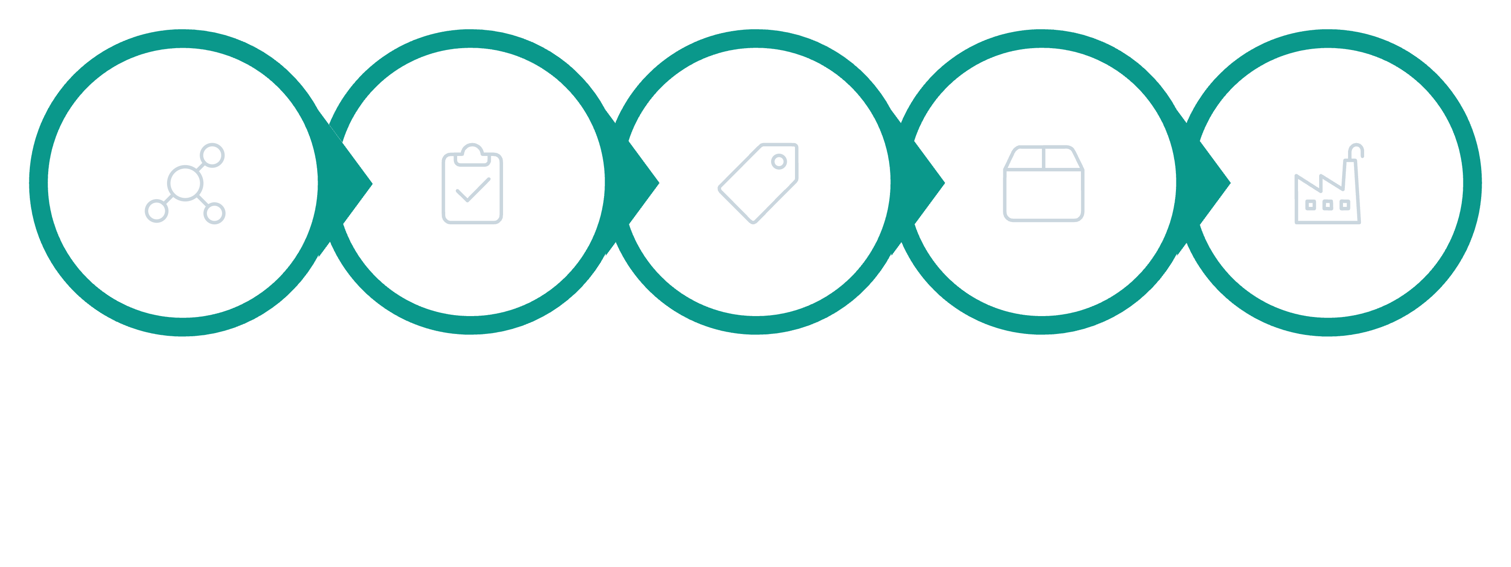
PRIVATE LABEL
Private Label — From $5,000 Per SKU
A scalable route for clinics, physician networks and distributors seeking their own brand architecture.
Select Peptide
Confirm Specs
Brand Review
Production & COA
Packaging
What Globalis Group Can Support
Program Variables
Tiered sourcing economics
Private-label programs from $5,000 per SKU
COA documentation
California manufacturing partner
B2B support across the Americas
Minimum order / lead time by SKU
Vial strength and pack configuration
Label claims and local-country requirements
Shipping, importation and distribution terms

Slide 12


AMERICAS FOCUS
Built for the Americas
A B2B commercial platform designed to support healthcare, specialty clinics and distribution partners across diverse markets.
North America
Mexico / Central America / Caribbean
United States • Canada
Advanced biopharma infrastructure, high peptide adoption, strong specialty-clinic market.
Mexico • Central America • Caribbean
Growing private healthcare, wellness and medical-tourism ecosystems.
South America
Brazil • Colombia • Chile • Argentina + regional markets
Large urban healthcare systems and expanding specialty / private-care demand.
Local authorization, importation, compounding,, advertising and professional-practice rules must be assessed in each destination country.

Slide 13
COMPLIANCE
Compliance-First Commercialization
The same molecule can sit in very different regulatory categories depending on product, indication, formulation and jurisdiction.
FDA-Approved Drug
Compounded Drug
Approved NDA / ANDA or biologic pathway. Claims limited to approved labeling and product-specific authorization.
503A / 503B conditions in the U.S. Not FDA-approved; must satisfy applicable compounding-law conditions and bulk-substance requirements.
Investigational
Research Use
IND / clinical development context. Human administration requires appropriate regulatory authorization and protocol controls.
Laboratory / non-clinical context. Must not be promoted or supplied as an unapproved human drug when that would violate applicable law.
Three Critical Distinctions: COA ≠ FDA approval • FDA registration ≠ FDA certification/approval • PCAC recommendation/review ≠ final FDA action

Slide 14
WHY GLOBALIS GROUP
A Flexible Supply Partner for the Americas
01
02
03
Competitive Pricing
California Manufacturing
COA Transparency
Volume-sensitive purchasing tiers at $1K / $5K / $10K.
U.S.-based manufacturing relationship with documentation available for professional review.
Analytical documentation available to support quality review and traceability.
04
05
Private Label
Americas Focus
Client-owned branding available from $5,000 per SKU, subject to feasibility and compliance.
Commercial support for North, Central and South American markets.

Slide 15

SOURCES & DATA NOTES
Selected Sources & References
U.S. FDA
U.S. FDA — PCAC
Certain Bulk Drug Substances for Use in Compounding that May Present Significant Safety Risks (updated 2026).
Pharmacy Compounding Advisory Committee meeting materials, July 23–24, 2026.
U.S. FDA — GDUFA
U.S. FDA — Prescribing Information
2025 GDUFA peptide workshop: "Over 130 FDA approved peptide drug products are designated as reference listed drugs."
Approval records: EGRIFTA WR (tesamorelin), Vyleesi (bremelanotide), Zepbound (tirzepatide), Forzinity (elamipretide).
Grand View Research
Peer-Reviewed Literature
Peptide Therapeutics Market Size & Share Report 2026–2033; U.S. Peptide Therapeutics Market Outlook 2026–2033.
Therapeutic peptide reviews in Amino Acids (2025), Journal of Clinical Pharmacology (2025), and related 2025–2026 literature.
Data note: market forecasts vary significantly by methodology and category definition. Figures shown are directional third-party estimates, not a valuation or revenue forecast for Globalis Group.

Slide 16

Next Step → Request the current SKU list with pricing, COA package and private-label scope for your target market.
info@globalisgroup.net
(619) 721-4955
www,globalisgroup.net

